Slide 1


FACULTY OF ENGINEERING
AND SCIENCE
Notes:
Pr- 1/7 2021

Slide 2

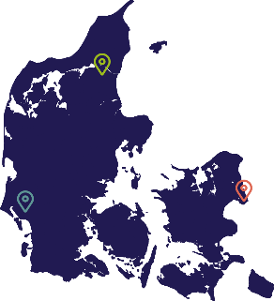

AAU = Knowledge for the world
18,660 students (excl. part-time students)
2,850 part-time students
820 PhD students
RESEARCH AND EDUCATION
STUDENTS
EMPLOYEES
Faculty of Social Sciences and Humanities
Faculty of Medicine
Faculty of Engineering and Science
Technical Faculty of IT and Design
18,660 students (excl. part-time students)
2,850 part-time students
820 PhD students
2,332 staff members in research and education
  Of which 710 international researchers
1,329 administrative staff

Slide 3
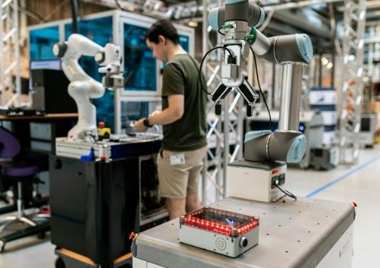

FACULTY OF ENGINEERING AND SCIENCE
At the Faculty of Engineering and Science, we address global societal challenges through research, education and knowledge collaboration.
We work across disciplines and sectors - emphasizing cooperation with businesses and public sector authorities - so that our research creates knowledge for the world.
Among the major global challenges that we are helping to solve are:
The transition to green energy
Ensuring clean water for the world's population
Sustainable construction
Smart and innovative methods of production.

Slide 4
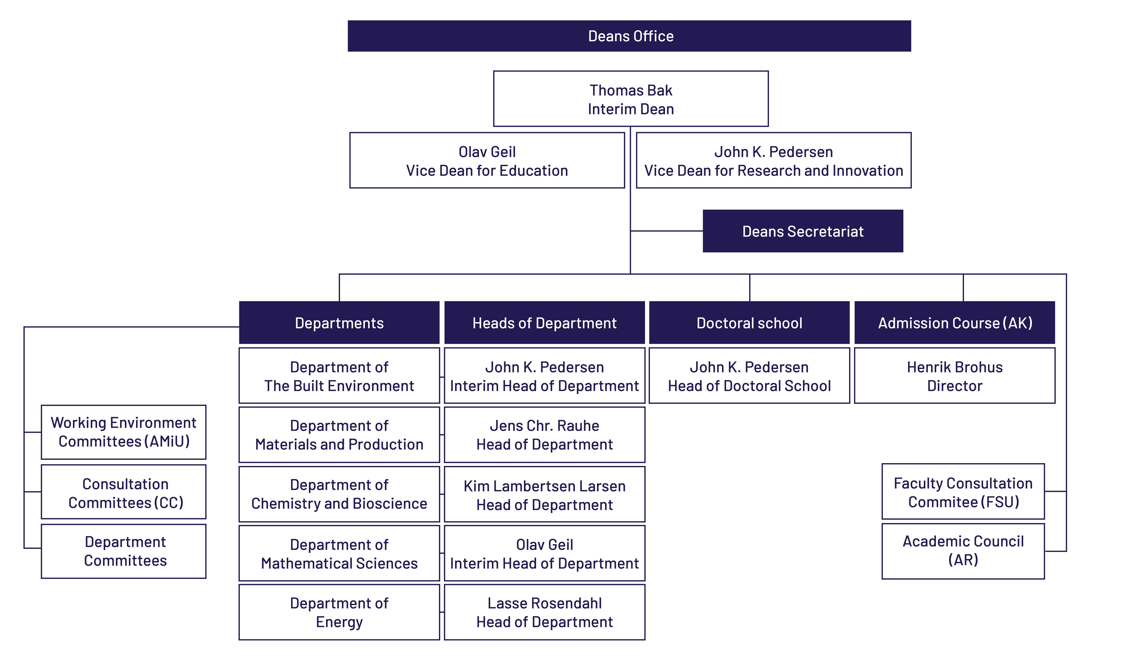
ENGINEERING - ORGANISATION
Notes:
Pr. 1/7-2021

Slide 5









MANAGEMENT - ENGINEERING
Thomas Bak
Interim Dean
John K. Pedersen
Vice Dean for Research and Innovation
Olav Geil
Vice Dean for Education
John K. Pedersen
Interim Head of Department
The Built Environment
Jens Chr. Rauhe
Head of Department Materials and Production
Kim Lambertsen Larsen
Head of Department
Chemistry and Bioscience
Olav Geil
Interim Head of Department
Mathematical Science
Lasse Rosendahl
Head of Department
Energy
Henrik Brohus
Head of Admissions Course

Slide 6

HIGH INTERNATIONAL LEVEL
1
NO. 1 IN EUROPE FOR ENGINEERING
NO. 1 IN EUROPE AND
NO. 4 IN THE WORLD FOR ENGINEERING PROGRAMS
BEST DANISH UNIVERSITY FOR PARTNERING WITH INDUSTRY
Aalborg University is the eleventh best university worldwide for engineering and the highest ranked European university in the field.
U.S. News & World Report, 2023
MIT analysis ranks Aalborg University as best in Europe and No. 4 in the world for engineering programs.
MIT report: “The global state of the art in engineering education, 2018”
The Confederation of Danish Industry (DI) has designated Aalborg University the best Danish university to partner with.
DI analyse 2020: Danmark tilbage på
vidensporet V
Notes:
Ranking of Aalborg University - Aalborg University (aau.dk)

Slide 7

EUROPE’S BEST ENGINEERING PROGRAMMES AND THE
FOURTH BEST IN THE WORLD
According to MIT and 50 global thought leaders.
AAU is surpassed by only three American universities.
TOP 5:
1. Olin College of Engineering (US)
2. Massachusetts Institute of Technology (MIT) (US)
3. Stanford University (US)
4. Aalborg University - AAU (DK)
5. Delft University of Technology (NL)
Notes:
MIT Report: ”The global state of the art in engineering education” (Graham, Ruth for MIT, 2018)
Rapport from Massachusetts Institute of Technology (MIT) from marts 2018.

Slide 8


SUSTAINABILITY AT AAU
AAU is ranked in the top 10 in the world for sustainability and holds the 9th position globally out of 1600 universities on The Times Higher Education Impact Ranking list.
AAU's achievements include moving from a position between 101-200 to 18th place on SDG 7: Affordable and Clean Energy, which is primarily due to AAU's commitment. Additionally, AAU has improved from the 43rd spot to the 7th position on SDG 14: Life Below Water.
Furthermore, AAU is the second-best university in the world concerning several Sustainable Development Goals:
  SDG 4: Quality Education
  SDG 10: Reduced Inequalities
  SDG 17: Partnerships for the Goals
On seven SDGs, AAU ranks within the top 25 (SDG 4, 6, 7, 10, 13, 14, and 17
  THE Impact Ranking 2023.
Notes:
Ranking inden for bæredygtighed - Aalborg Universitet (aau.dk)

Slide 9
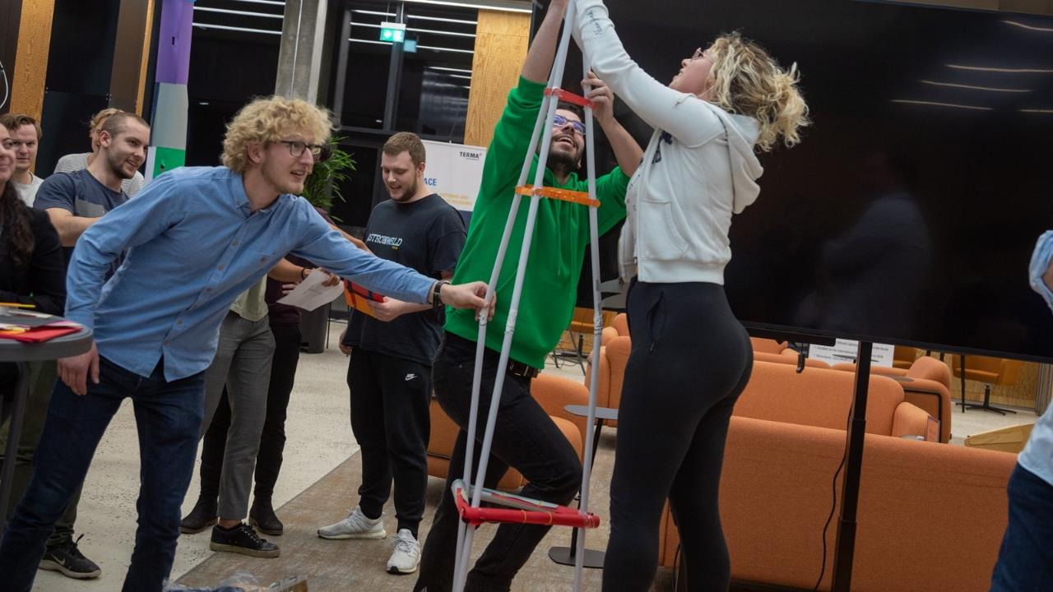
EDUCATION

Slide 10
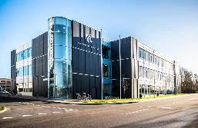


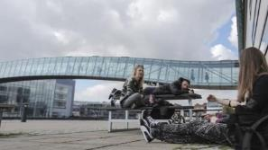
KEY FIGURES FOR ENGINEERING
Education
AALBORG
since 1974
Departments: Chemistry, Biology, Mathematics, Physics, Energy, Construction, Materials and Production
5 departments
67 educations
2,600 students
290 PhD students
860 FTEs
DKK 930 mio.
(revenue)
ESBJERG
since 1995
COPENHAGEN
since 2003
Notes:
DK-billede erstattes: https://www.colourbox.com/vector/denmark-vector-2332864
Antal studerende: Nøgletal for studerende - Aalborg Universitet (aau.dk)
Antal Ph.d. studerende: Key figures for research at Aalborg University - Aalborg University (aau.dk)

Slide 11
Education
Easy access to researchers and research environments
Close collaboration with the business community
Uddannelses-
miljø
På ENGINEERING
EDUCATIONAL ENVIRONMENT AT ENGINEERING
Strong collaboration skills as a result of PBL
A vibrant study environment in rapid Development, located in a lively city
Bidrager til samfundets vækst
og udvikling
Notes:
Et tæt samarbejde med erhvervslivet
Tæt på forskningsmiljøer
Stærke samarbejdsevner som resultat af gruppearbejde
Et studiemiljø i rivende udvikling i samarbejde med de studerende

Slide 12

STUDENTS AT ENGINEERING
2017-2021
Education
Graduates complete their studies in an average of 5,1 years
Notes:
Antallet af studerende har en faldende tendens siden 2017. Lukket flere end vi har åbnet. Flere ind på de eksisterende uddannelser.
Note: Opgjort som bestand 1/10 2021. Omfatter ordinære heltidsstuderende, gæste studerende, adgangskursus og deltidsuddannelser
Kilde: Qlikview. Antal studerende Kilde: Troels Frøkjær Christensen

Slide 13




PROBLEM AND PROJECT-
BASED LEARNING
(THE AAU APPROACH)
Education
P B L
Students are encouraged to solve a problem
– they learn through problem solving.
Students complete a project in groups.
Students have an academic supervisor who assists them in the project process, challenges and discusses their ideas, and provides feedback on their project work.
Students document their work in a project report which is the subject of an oral (group) examination.
Aalborg University is the home of a UNESCO Center for Problem-Based Learning in Engineering Science and Sustainability

Slide 14
Education
PROBLEM BASED LEARNING (PBL)
LITERATURE
TEACHING
GROUP WORK
PROBLEM ANALYSIS
PROBLEM SOLUTION
PROJECT / DOCUMENTATION
GUIDANCE
WORK
EXPERIMENTS
The PBL model

Slide 15
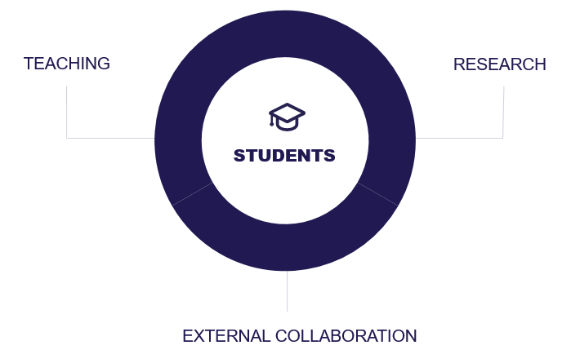
ELEMENTS IN THE
LEARNING PROCESS
Education
COLLABORATION
50%
50% of the master’s thesis are produced in
collaboration with
companies/ external partners
I 50% of all master theses
were prepared in collaboration with companies or other external partners
Notes:
Note: Kandidatspecialer i samarbejde med virksomheder og eksterne partnere er 50%
Kilde: Udgivelsen ”Sammen skaber vi VIDEN FOR VERDEN” fra 2020: http://www.e-pages.dk/aalborguniversitet/825/html5/

Slide 16
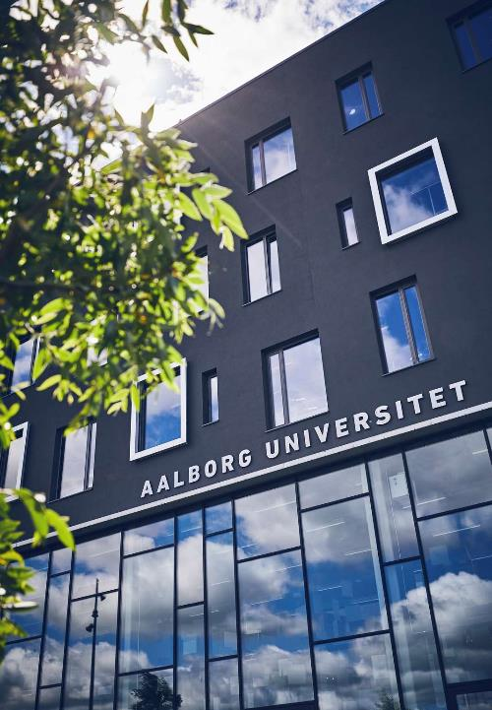
INSTITUTE FOR ADVANCED STUDY IN PBL (IAS PBL)
Education
The Institute for Advanced Study in PBL (IAS PBL) is a cross-faculty unit that aims to strengthen the quality and development of PBL research and practice across AAU.
IAS PBL will function as a hub for research, knowledge sharing, competence development, collaboration and experiments with PBL.
As a hub for research, development and knowledge sharing, a central task for IAS PBL is to engage and work closely with local environments in all faculties, departments, and organisational units.
Notes:
About IAS PBL - Aalborg University (aau.dk)

Slide 17
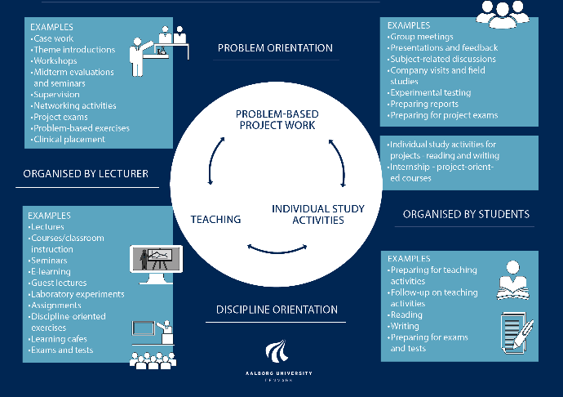
STUDY ACTIVITY MODEL
Education
Our educational programs combine traditional teaching with problem-based learning (PBL).
We work closely with the business community.
We promote coherence between engineering and science educations.
Interdisciplinary collaboration based on clear professional competencies and self-understanding is highly valued.
Students work with considerable freedom in their projects and receive tailored support from supervisors.
Project participants are individually assessed through a thorough group examination (3-4 hours).
All projects are based on real-world problems.

Slide 18
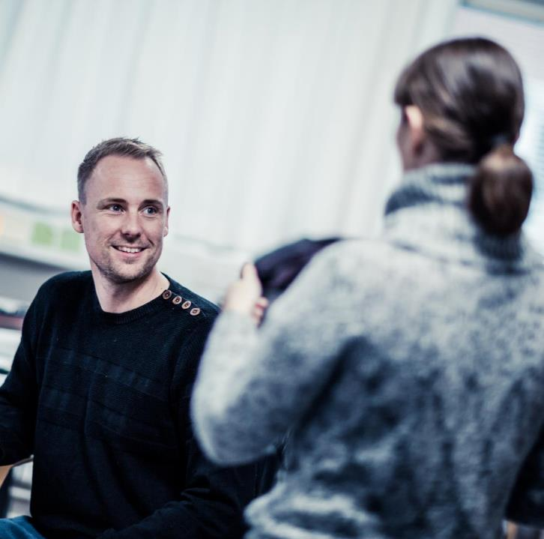
EMPLOYABILITY
Education
90,8 % of the master graduates from ENGEERING are in jobs within 4.-7 quarter after graduation.
On average, 61% of AAU graduates find employment in the private sector.
The PBL- model provides students with competencies that are in demand in business. It pays off in job opportunities after graduation.
Notes:
Kilde: AAU, QlickView, Ledighedsstatistik 2019.
Analysen for årgang 2015/16 er baseret på i alt 576 ud af 594 kandidatdimittender samt i alt 42 ud af 46 professionsbachelorer.
I gennemsnit får 61 % af AAU’s dimittender beskæftigelse i den private sektor
Kilde: Udgivelsen ”Sammen skaber vi VIDEN FOR VERDEN” fra 2020: http://www.e-pages.dk/aalborguniversitet/825/html5/

Slide 19
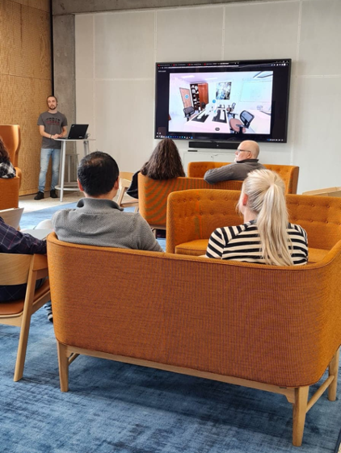
Microcredentials- digital learning units
Education
As a PBL university, we have special prerequisites for benefiting from digitization in our education. We achieve this through Microcredentials, which:
are small digital learning units that can be taken by students across AAU and throughout the educational journey.
support the students' project work on-demand and provide them with opportunities to pursue their own interests.
can be used as pure extracurricular activities.
have the potential to bridge day studies with Continuing Education (EVU), including preparing regular students for subsequent lifelong learning.
share research-based knowledge with the aim of expanding students' and educators' horizons.

Slide 20

leadENG
Development of future sustainable solutions
Education
leadENG projects provide students with unique opportunities for collaboration across study programs and disciplines.
Through the projects, the students gain a special understanding of their discipline as it relates to other areas.
In the business world, collaboration skills and a keen awareness of one's own expertise are highly valued competencies, forming the bedrock for delivering sustainable and interdisciplinary solutions to society's most pressing challenges.

Slide 21




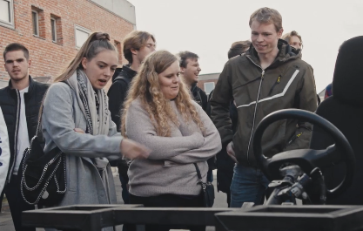



MORE ABOUT leadENG
Education
Presentation video
Website

Slide 22
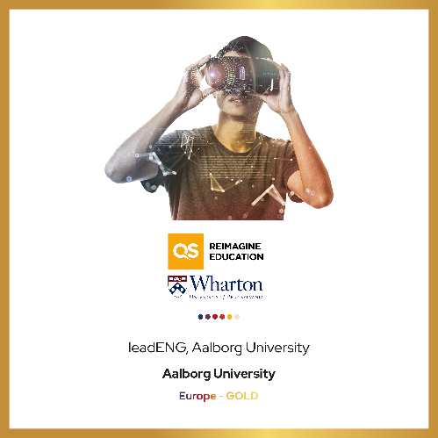
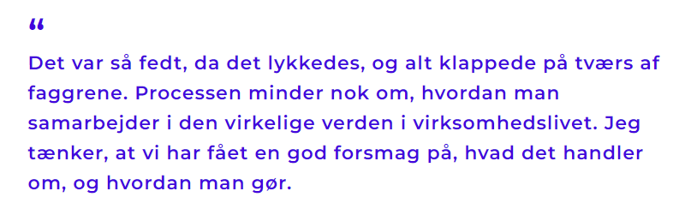
INTERNATIONALLY AWARD-WINNING CONCEPT
Education
leadENG was nominated in the category 'Developing Emerging Skills and Competencies' and won the overall award across categories as the most innovative educational concept in all of Europe.
Jonas Lindegaard Mikkelsen, a student in engineering, talks about participating in a leadENG project.
Notes:
Jonas Lindegaard Mikkelsen, studerende på ingeniørvidenskab, om at deltage i et leadENG-projekt.

Slide 23




Education
COLLABORATION WITH STUDENTS STRENGTHENS COMPANIES
More than 90 percent of our collaborating companies assess that working with students from AAU strengthens their business to some extent or significantly. This is attributed to several factors, including:
Testing out new ideas
Solving specific challenges
Opening the path for collaboration with AAU in other fields
Improved opportunities for recruiting skilled workforce (e.g., by hiring students)

Slide 24

KNOWLEDGE COLLABORATION

Slide 25
VALUE FOR SOCIETY
Collaboration
ENHANCING
COMPETITIVENESS
GROWING
PRODUCTIVITY
PROMOTING
INNOVATION CULTURE
Just under 90% of the companies will enhance their competitiveness to a large or some extent when collaborating with AAU.
The productivity of the companies grows 12% on average
when collaborating with AAU.
More than 90% of public collaboration partners state that they have received new inspiration and acquired new competences through their collaboration with AAU.
Notes:
Note:
AAU’s problem-oriented approach to research/education creates knowledge and solutions that change the world.
ENHANCING COMPETITIVENESS
Source: Source for all figures: IRISgroup (2021), Fra viden til samfundsnytte - Aalborg Universitets bidrag til innovation, iværksætteri og grøn omstilling [From knowledge to use for the community - Aalborg University’s contribution to innovation, entrepreneurship, and green transition.
GROWING PRODUCTIVITY
Over a period of 8 years, the productivity of the companies grows 12% on average
Source: IrisGroup (2017): Aalborg Universitets vidensamarbejde – effekter for virksomheder, myndigheder og samfund [Aalborg University’s knowledge collaboration – effects for companies, public authorities and the society]
PROMOTING INNOVATION CULTURE
Public organisations also benefit significantly from their collaboration with Aalborg University.
Annually, Aalborg University enters into 400-500 collaboration agreements with public organisations.
Source: IrisGroup (2017): Aalborg Universitets vidensamarbejde – effekter for virksomheder, myndigheder og samfund [Aalborg University’s knowledge collaboration – effects for companies, public authorities and the society]

Slide 26
AALBORG UNIVERSITY COLLABORATES WITH COMPANIES ACROSS DENMARK
Collaboration
26
29%
24%
14%
31%
2%
NORTH DENMARK REGION
CENTRAL DENMARK REGION
REGION OF SOUTHERN DENMARK
CAPITAL REGION OF DENMARK
REGION ZEALAND
Notes:
Fordeling af virksomheder, der samarbejder med AAU
Note: Opgørelsen omfatter alene private virksomheder
AAU samarbejder med et bredt udsnit af det danske erhvervsliv. AAU’s hyppigste samarbejdspartnere er industrivirksomheder og IKT-virksomheder
Note: Industrivirksomheder udgør knap 40%, og IKT-virksomheder udgør knap 25%
AAU samarbejder hyppigst med virksomheder, der beskæftiger 20-49 årsværk samt virksomheder, der beskæftiger over 100 årsværk.
Note: begge grupper udgør hver omkring 35% af AAU’s samarbejdspartnere
Over en trejdedel af AAU’s samarbejdsvirksomheder har en høj FoU-intensitet
Note: Høj FoU-intensitet er virksomheder, hvis udgifter til forskning og udvikling udgør mere end 10% af omsætningen.
Kilde til alle tal: IRISgroup (2021), Fra viden til samfundsnytte - Aalborg Universitets bidrag til innovation, iværksætteri og grøn omstilling

Slide 27

AAU COLLABORATES WITH COMPANIES ACROSS DENMARK
Collaboration
AAU’s collaboration partners include a high proportion of industrial companies and IT companies.
AAU collaborates mostly with companies who employee 20-49 full-time equivalents as well as companies who employee more than 100 full-time equivalents
More than a third of AAU’s business partners have a high R&D intensity.
Notes:
Distribution of companies collaborating with AAU
Note: The figures only include private companies
AAU’s collaboration partners include a high proportion of industrial companies and IT companies
Note: Just under 40% industrial companies and just under 25% IT companies
AAU collaborates mostly with companies who employee 20-49 full-time equivalents as well as companies who employee more than 100 full-time equivalents
Note: each group make up about 35% of AAU’s business partners.
More than a third of AAU’s business partners have a high R&D intensity.
Note: Companies with a high R&D intensity are defined as companies that spend more than 10% of their turnover on R&D.
Source for all figures: IRISgroup (2021), Fra viden til samfundsnytte - Aalborg Universitets bidrag til innovation, iværksætteri og grøn omstilling [From knowledge to use for the community - Aalborg University’s contribution to innovation, entrepreneurship, and green transition]

Slide 28

TRADITION OF COLLABORATION
Collaboration
AAU’s problem-based research and learning model creates change.
Research is conducted in close collaboration with the Danish business community and public partners.
AAU culture supports the vigour and zeal of AAU staff and students.
Strong focus on developing new ways of supporting knowledge collaboration.
Notes:
AAU’s skills and desire to collaborate are rooted in the four distinctive features that AAU has defined in its strategy: Problem orientation, Collaboration, Commitment and Change.
It is not the individual distinctive feature, but the combination that makes AAU’s basis for collaboration unique.
Source: AAU Strategy 2022-2026 Knowledge for the World

Slide 29
STRONG COLLABORATION SKILLS
Collaboration
THE PREFERRED COLLABORATION PARTNER OF THE DANISH BUSINESS WORLD
FLEXIBLE APPROACH TOWARDS COLLABORATION
THE BEST AT ESTABLISHING COLLABORATION AGREEMENTS
AAU ranks first on the list from the Confederation of Danish Industry (DI) of how satisfied Danish companies are with collaborating with Danish universities.
Research-intense companies consider AAU to be the best Danish university at handling the process from patent to commercialisation.
Between 500 and 600 research partnerships are annually established between AAU and public/private actors.
Notes:
Collaborative research with universities is vital for the innovation, productivity and growth of companies. Even the knowledge of companies with their own development departments is limited. Therefore, external input, ideas and knowledge are vital.
In DI’s report from 2016, research-intensive companies state that the reason for their assessment of Aalborg University is that AAU has a flexible and pragmatic approach towards collaboration with companies.
Source: Report from the Confederation of Danish Industry, DI Analyse (2016): Knaster i samarbejde om forskning – men også positive tendenser [Hurdles in research collaboration - as well as positive trends].
THE PREFERRED COLLABORATION PARTNER OF THE DANISH BUSINESS WORLD
Source: DI (2021): Danmark på vidensporet V [Denmark on Knowledge Track V]
FLEXIBLE APPROACH TOWARDS COLLABORATION
Source: Report from the Confederation of Danish Industry, DI Analyse (2016): Knaster i samarbejde om forskning – men også positive tendenser [Hurdles in research collaboration - as well as positive trends].
THE BEST AT ESTABLISHING COLLABORATION AGREEMENTS
Source: Ministry of Higher Education and Science (2021): Viden til vækst – Offentlig-privat samspil om forskning [Knowledge for growth – Public-private interaction on research] (kommercialiseringsstatistikken)

Slide 30

KNOWLEDGE COLLABORATION
– BINDING, FOCUSED AND MUTUAL
Collaboration
Cluster partnerships
Entrepreneurship
SME partnerships
Strategic partnerships
Industrial PhDs, postdocs, 20% professors, etc.
Student collaboration (projects, practicums, student jobs)
Research partnerships

Slide 31


INNOVATION AND ENTREPRENEURSHIP
Collaboration
AAU works strategically on entrepreneurship for students and researchers.
AAU Science and Innovation Hub
launched.
Incubator
Venture Cup – Startup Competition
Venture Cup – Idea Competition
Spin In
Workshops
Entrepreneurship and innovation courses integrated in curricula
Wofie
Solution Camp
Business Booth
Drop-in advice for entrepreneurs,
regardless of the step they are on.
Notes:
Aalborg Universitet tilbyder en række kurser og workshops inden for innovation og entreprenørskab. Det ene step leder naturligt tankerne hen på næste, og vi er med hele vejen for at give de studerende de bedste muligheder.
For flere detaljer: www.sea.aau.dk
Innovation og entrepreneurship er strategisk prioriterede indsatser på AAU, og der er udviklet indsatser, der tager højde for at de studerende er på forskellige niveauer både interessemæssigt og udviklingsmæssigt i forhold til deres forretningsideer.
De tidlige indsatser handler i høj grad om at stimulere de studerendes lyst og motivation omkring innovation, og en mulighed for at give dem en oplevelse med at arbejde med idegenerering, innovation, forretningsudvikling og præsentationsteknik.
Derudover arbejdes der i høj grad ekstracurriculært, med indsatser der har til formål at udvikle de forretningsideer de studerende kommer med, og sikre at de studerende får en mulighed for at teste deres iværksætterpotentiale gennem workshops, samarbejde med etablerede virksomheder, mentorer og forretningsudviklere. Desuden deltager AAU i den nationale forretningsplanskonkurrence for universiteterne; Venture Cup.

Slide 32
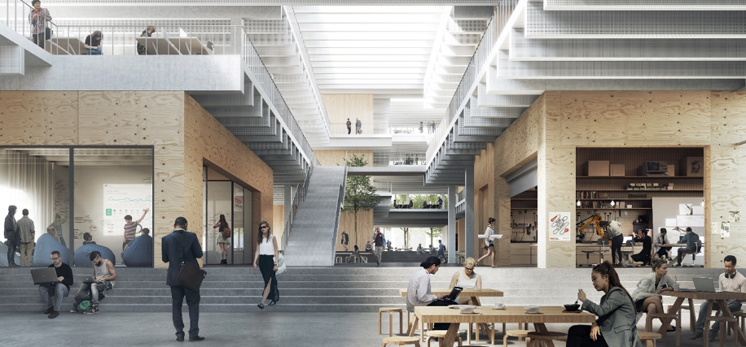
AAU SCIENCE &
INNOVATION HUB
Collaboration
INTERDISCIPLINARY RESEARCH
TALENT AND BUSINESS DEVELOPMENT
WORKSHOPS AND PROTOTYPE LABS
INCUBATOR ENVIRONMENT FOR STUDENTS/YOUNG RESEARCHERS

Slide 33
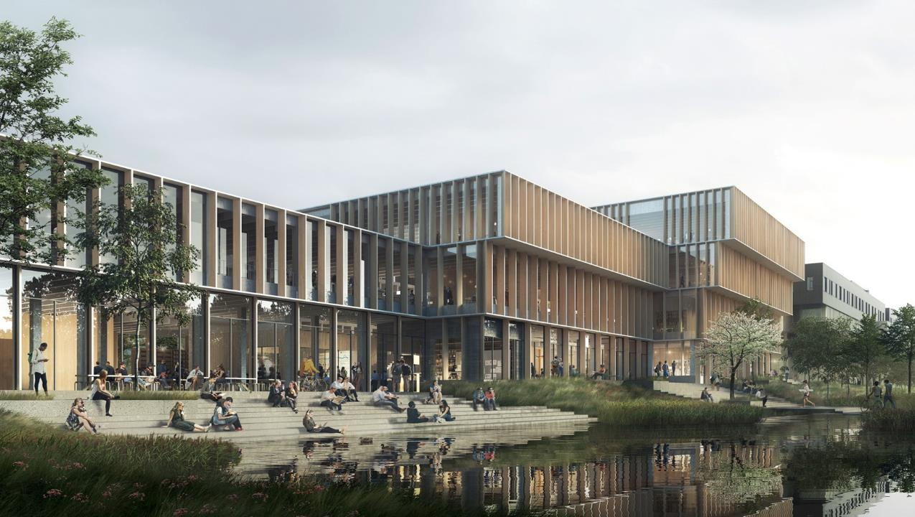
DEPARTMENTS

Slide 34

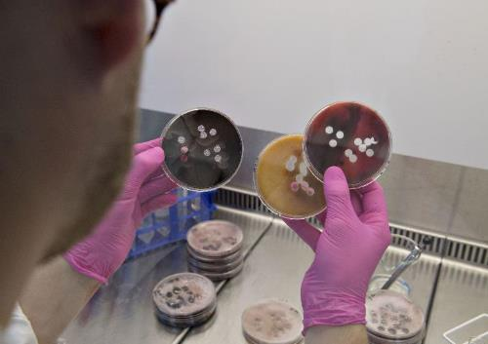
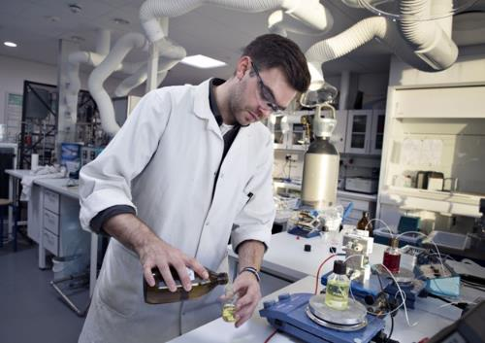


DEPARTMENT OF CHEMISTRY AND BIOSCIENCE
Departments
The Department of Chemistry and Bioscience conducts research and trains students in chemistry, environment, biology and biotechnology. The department has a tradition of collaborating with the business community on new and innovative research, nationally as well as internationally.
POSITIONS OF STRENGTH NOW AND IN THE FUTURE
Environmental biotechnology
Environment, nature & biodiversity
Sustainable and circular economy
Glass – endless application opportunities
Medical biotechnology and personalised medicine
RESEARCHHIGHLIGHTS
Microflora Danica – mapping of all microorganisms in Denmark
Collaboration with SSI on genetic sequencing of positive coronavirus test-samples
Sustainable mould-based batteries
World's most unbreakable glass and self-healing glass

Slide 35
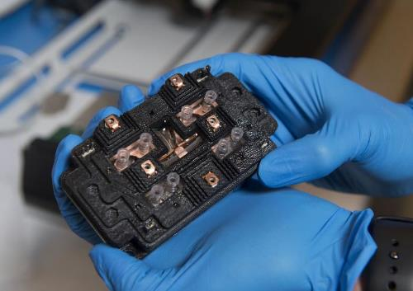
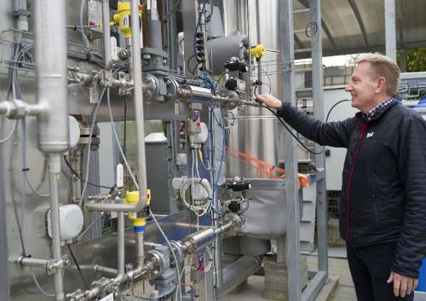


DEPARTMENT OF ENERGY
Departments
The Department of Energy trains students and conducts research in areas such as energy efficiency, renewable energy, electrification and CO2 storage. With this focus, the department invests its expertise and impact in the green transition.
POSITIONS OF STRENGTH NOW AND IN THE FUTURE
Power electronics
Smart energy systems
Sustainable fuel and biorefinery
Electrified and integrated renewable energy systems
Digitalisation and AI in energy systems
FORSKNINGSMÆSSIGE HIGHLIGHTS
Extensive external funding and numerous awards in power electronics
Power-to-Methanol plant in operation; first Danish PtX plant on a pilot scale

Slide 36




DEPARTMENT OF THE BUILT ENVIRONMENT
Departments
BUILD conducts research, trains students and consults in the urban, residential, construction and infrastructure areas. Based on this the department contributes to solving society's biggest challenges, such as the climate crisis, population development, resource scarcity and urbanisation.
POSITIONS OF STRENGTH NOW AND IN THE FUTURE
Sustainable construction, including health and indoor climate
Transformation of homes and places, including urban-rural relocation patterns
City's water and pollution, including ocean and coastal structures
RESEARCH HIGHLIGHTS
Development of LCA methods and tools for assessing the climate and environmental
impact of construction
Young talented researchers through the eye of the needle for Data.org’s
"Inclusive Growth and Recovery Challenge" programme
MarinePlastic – BUILD researchers are key players in the interdisciplinary research centre
for plastic pollution in the world's oceans

Slide 37
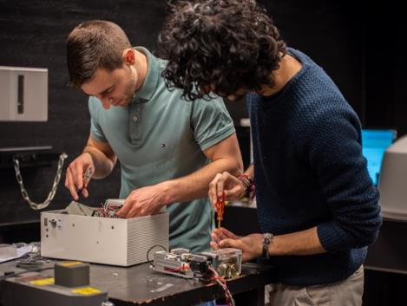
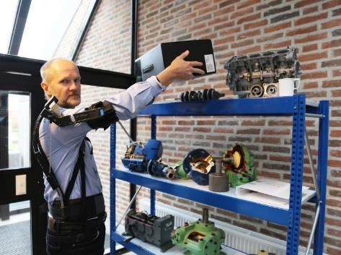



DEPARTMENT OF MATERIALS
AND PRODUCTION
Departments
The Department of Materials and Production conducts research and trains students in materials, mechanics, physics, production and production management. With this starting point, the department strives to develop materials, products and production systems for future needs.
POSITIONS OF STRENGTH NOW AND IN THE FUTURE
Exoskeletons (wearable robots)
Circular materials and processes
Digitisation of production – Industry 4.0
Biomechanics
Computational mechanics
RESEARCH HIGHLIGHTS
Novo Nordisk Foundation grant for interdisciplinary biomechanics project
Innovation Factory North – technology and competence development in
manufacturing companies
Innovation Fund Denmark project on Recycling Plastic with partners including
Grundfos and LOGSTOR

Slide 38





DEPARTMENT OF MATHEMATICAL SCIENCES
Departments
The Department of Mathematical Sciences conducts research and trains students in mathematics, mathematics-technology and mathematics-economics. The department's research contributes to basic scientific discoveries and to solving society's challenges.
POSITIONS OF STRENGTH NOW AND IN THE FUTURE
Data Science and AI
Spatial statistics
Forensic genetics
Numerical and Mathematical Physics
Topological Data Analysis
RESEARCH HIGHLIGHTS
Grant from the Novo Nordisk Foundation for the project "AI – Aalborg Intelligence
" that will design courses that use artificial intelligence to make mathematics
in high school more exciting
Groundbreaking results on matching of Y-chromosomes
World-leading research on spatial statistics with publications in the highest rated
journals in statistics: Annals of Statistics and Journal of the American
Statistical Association

Slide 39


AAU STRATEGY
KNOWLEDGE FOR THE WORLD 2022-26

Slide 40


KNOWLEDGE FOR THE WORLD
Strategy
Knowledge for the World
Knowledge for the World 2022-26
We are internationally recognised as a mission-oriented university that contributes
to sustainable development
Prioritering og råderum
Videreudvikling af AAU-særkender
Strategisk ageren
Digitale muligheder
50%
Knowledge for the World 2016-21
A coherent and consolidated AAU
Quality
Professionalisation
Identity
I 50% of all master theses
were prepared in collaboration with companies or other external partners

Slide 41

AAU VISION 2026
Strategy
We are internationally recognised as a mission-oriented university that contributes to sustainable development.
  Outstanding foundational, transformative and interdisciplinary research.
  Graduates with in-depth, discipline-specific knowledge and a focus on holistic thinking
  Developing our problem- and project-based learning model with a focus on e.g., digitalization and entrepreneurship
  An attractive partner for private companies and public sector authorities and institutions.
  Sustainability is a central theme.
Notes:
With its mission-oriented approach, Aalborg University will set a clear direction and create value through new knowledge about - and for - the world. Through high quality in our core activities, we will help create solutions to complex societal challenges regionally, nationally and globally.
We are internationally recognised as a mission-oriented university that contributes to sustainable development.
We are internationally recognised for outstanding foundational, transformative and interdisciplinary research.
We produce graduates with in-depth, discipline-specific knowledge and a focus on holistic thinking who can contribute to - and collaborate on - solving present-day and future challenges.
We have developed our problem- and project-based learning model with a focus on digitalisation, entrepreneurship and the integration of SSH (social science and humanities) and STEM (science, technology, engineering and mathematics including IT).
We are an attractive partner for private companies and public sector authorities and institutions, and our knowledge partnerships are mutual, focused and help to create change.
Sustainability is a central theme of our activities.

Slide 42
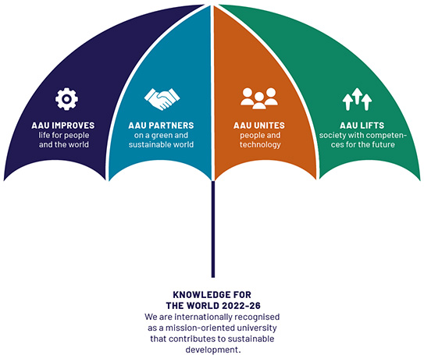
AAU’S THEMATIC APPROACH AS A MISSION-ORIENTED UNIVERSITY
Strategy
Notes:
To be a mission-oriented university requires that we work with missions within a defined thematic framework (cf. Illustration of the mission-oriented university). As an internationally recognised mission-oriented university, our vision states that we will contribute to the sustainable development of the world. Sustainability is therefore a key element of AAU's thematic approach.
The four themes that AAU will focus on in Knowledge for the World 2022-26 are:
AAU LIFTS society with competences for the future
We provide the labour market with entrepreneurial graduates capable of cooperation and who strengthen competitiveness and innovation.
Societal development requires holistically oriented graduates who can contribute to a more peaceful and sustainable world. Our graduates must be independent, critical thinkers with the highest level of knowledge and an innovative mindset. Through a focus on high academic expertise, problem-based learning, interdisciplinarity, the integration of STEM and SSH, innovation, entrepreneurship and lifelong learning, we will ensure that graduates acquire the competences demanded by the labour market of the future.
AAU PARTNERS on a green and sustainable world
We work with the world to transform the global community towards balance. We aim to help create a balanced and sustainable future for people and our planet. Sustainable development is about balancing environmental, political and health-related development, all of which are interconnected. Our work/business must be because we belong to a larger society and a common humanity. This emphasises the recognition of interdependence and interconnectedness between the local, the national and the global.
AAU IMPROVES life for people and the world
We offer solutions to the climate agenda – whether it's water, energy, health or anything else. We tackle the climate crisis with deep knowledge of technologies, business opportunities and essential considerations for democracy and the individual.
AAU UNITES people and technology
Through our academic strengths and interdisciplinary approach, we will help shape society and create opportunities through the development and integration of the technological, the digital and the human. We will explore the effect of technology on humanity. We have the finest knowledge that must play a greater role in the digital and technological transformation of our society, our industry, public and private companies, and our lives and actions as citizens.

Slide 43

AALBORG UNIVERSITETS VISION
MOD 2021
AAU fungerer og anerkendes som et universitet med en unik profil og med høj kvalitet i alle aktiviteter.
AAU er internationalt anerkendt for fremragende problem- og løsningsorienteret forskning.
AAU uddanner studerende til fremtidens samfund.
AAU udlever dets grundprincipper for problem- og projektbaseret læring og er internatonalt anerkendt for læringsformens dokumenterede resultater.
AAU er en attraktiv samarbejdspartner for virksomheder, myndigheder og institutioner, og vores vidensamarbejder er gensidige, fokuserede og særligt udvalgte.
SUSTAINABILITY AT AAU

Slide 44


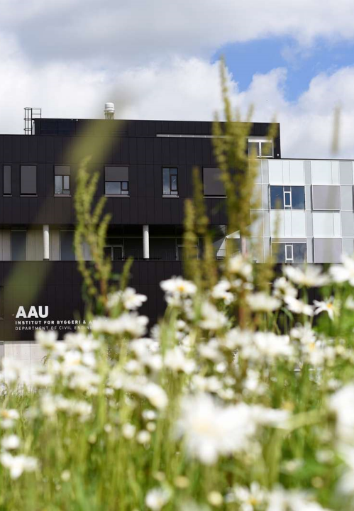
AALBORG UNIVERSITY POLICY ON BALANCED AND SUSTAINABLE DEVELOPMENT(EXCERPT)
Sustainability
AAU endeavours to:
Integrate environmental, financial and social sustainability at all levels of all strategic and operational activities.
Embody openness, co-determination and equal opportunities for all and a high level of diversity among staff and students.
Offer the highest quality education that prepares graduates with knowledge, commitment, critical thinking and practical tools that enable them to contribute to a sustainable society.
Deliver the highest quality research that contributes to sustainable and innovative solutions to societal challenges.
Take preventive measures to protect the environment and prevent the environmental impact of the operation of AAU.
Work with partners who contribute to sustainable development and promote sustainable development in conjunction with local, national and global actors.

Slide 45

CLIMATE GOALS FOR AAU
Sustainability
AAU has reduced greenhouse gas emissions by 70% by 2030 (compared to 1990).
AAU is climate neutral by 2045.
AAU will contribute to Denmark achieving the 70% target by 2030 and climate neutrality by 2045 in the best and cheapest way, as well as work on making it technologically, organisationally and humanely possible to fine-tune these goals.
Notes:
The strategy, Knowledge for the World 2022-26, includes a vision that AAU must contribute to sustainable development. As a knowledge institution, AAU will contribute to solving major challenges in society, including climate. AAU has therefore adopted three climate goals to support AAU's contribution to the green transition.
Kilde: Klimamål for AAU, Om AAU
Sustainability at AAU - Aalborg University

Slide 46
Det sundhedsvidenskabelige fakultet
AALBORG universitet

